Slide 1
Chapter 7
Section 7.1-7.2

Slide 2

I/O Streams
I/O refers to program input and output
Input is delivered to your program via a stream object
Input can be from
The keyboard
A file
Output is delivered to the output device via a stream object
Output can be to
The screen
A file

Slide 3
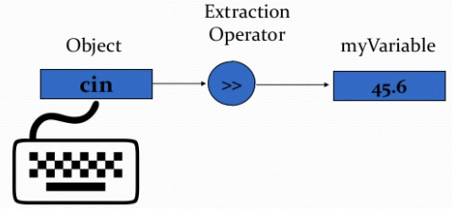
cin and cout Streams
cin
Input stream connected to the keyboard
cout
Output stream connected to the screen
cin and cout defined in the iostream library
Use include directive: #include <iostream>
You can declare your own streams to use with files

Slide 4
Chapter 7
Section 7.3

Slide 5
Tools for Stream I/O
To control the format of the program's output
We use commands that determine such details as:
The spaces between items
The number of digits after a decimal point
The numeric style: scientific notation or fixed point
Showing digits after a decimal point even if they are zeroes
Showing plus signs in front of positive numbers
Left or right justifying numbers in a given space

Slide 6
Formatting Output to Files
Format output to the screen with: cout.setf(ios::fixed); cout.setf(ios::showpoint); cout.precision(2);
Format output to a file using the out-file stream named out_stream with: out_stream.setf(ios::fixed); out_stream.setf(ios::showpoint); out_stream.precision(2);

Slide 7
out_stream.precision(2);
precision is a member function of output streams
After out_stream.precision(2); Output of numbers with decimal points…
will show a total of 2 significant digits 23. 2.2e7 2.2 6.9e-1 0.00069 OR
will show 2 digits after the decimal point 23.56 2.26e7 2.21 0.69 0.69e-4
Calls to precision apply only to the stream named in the call

Slide 8
setf(ios::fixed);
setf is a member function of output streams
setf is an abbreviation for set flags
A flag is an instruction to do one of two options
ios::fixed is a flag
After out_stream.setf(ios::fixed); All further output of floating point numbers…
Will be written in fixed-point notation, the way we normally expect to see numbers
Calls to setf apply only to the stream named in the call

Slide 9
setf(ios::showpoint);
After out_stream.setf(ios::showpoint);
Output of floating point numbers…
Will show the decimal point even if all digits after the decimal point are zeroes

Slide 10
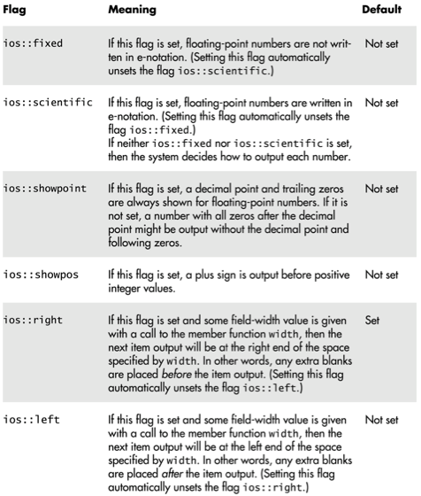
Formatting flags
for setf

Slide 11
Creating Space in Output
The width function specifies the number of spaces for the next item
Applies only to the next item of output
Example:
To print the digit 7 in four spaces use
out_stream.width(4); out_stream << 7 << endl;
Three of the spaces will be blank
7
7
(ios::right)
(ios::left)

Slide 12
Not Enough Width?
What if the argument for width is too small?
Such as specifying cout.width(3); when the value to print is 3456.45 ?
The entire item is always output
If too few spaces are specified, as many more spaces as needed are used
So when specifying the width, you need to assume the maximum width you need

Slide 13
Unsetting Flags
Any flag that is set, may be unset
Use the unsetf function
Example: cout.unsetf(ios::showpos); causes the program to stop printing plus signs on positive numbers

Slide 14
Manipulators
A manipulator is a function called in a nontraditional way
Manipulators in turn call member functions
Manipulators may or may not have arguments
Used after the insertion operator (<<) as if the manipulator function call is an output item

Slide 15
The setw Manipulator
setw does the same task as the member function width
setw calls the width function to set spaces for output
Example:
cout << "Start" << setw(4) << 10 << setw(4) << 20 << setw(6) << 30;
produces: Start 10 20 30
Two Spaces
Four Spaces

Slide 16
The setprecision Manipulator
setprecision does the same task as the member function precision
Example:
cout.setf(ios::fixed); cout.setf(ios::showpoint); cout << "$" << setprecision(2) << 10.3 << endl << "$" << 20.5 << endl; produces: $10.30 $20.50
setprecision setting stays in effect until changed

Slide 17
Manipulator Definitions
The manipulators setw and setprecision are defined in the iomanip library
To use these manipulators, add these lines #include <iomanip> using namespace std;

Slide 18
Chapter 7
Section 7.4

Slide 19
Why Use Files?
Files allow you to store data permanently!
Data output to a file lasts after the program ends
An input file can be used over and over
No typing of data again and again for testing
Create a data file or read an output file at your convenience
Files allow you to deal with larger data sets

Slide 20
Streams and Basic File I/O
Files for I/O are the same type of files used to store programs
A stream is a flow of data
Input stream: Data flows into the program
If input stream flows from keyboard, the program will accept data from the keyboard
If input stream flows from a file, the program will accept data from the file
Output stream: Data flows out of the program
To the screen
To a file

Slide 21
File I/O
Reading from a file
Taking input from a file
Done from beginning to the end (for now)
No backing up to read something again (OK to start over)
Just as done from the keyboard
Writing to a file
Sending output to a file
Done from beginning to end (for now)
No backing up to write something again (OK to start over)
Just as done to the screen

Slide 22
Stream Variables
Like other variables, a stream variable…
Must be declared before it can be used
Must be initialized before it contains valid data
Initializing a stream means connecting it to a file
The value of the stream variable can be thought of as the file it is connected to
Can have its value changed
Changing a stream value means disconnecting from one file and connecting to another

Slide 23
Declaring Input-File Stream Variable
Input-file streams are of type ifstream
Type ifstream is defined in the fstream library
You must use the include and using directives #include <fstream> using namespace std;
Declare an input-file stream variable using ifstream in_stream;

Slide 24
Declaring Output-File Stream Variable
Ouput-file streams of are type ofstream
Type ofstream is defined in the fstream library
You must use these include and using directives #include <fstream> using namespace std;
Declare an output-file stream variable using ofstream out_stream;

Slide 25
Connecting to a File
Once a stream variable is declared, connect it to a file
Connecting a stream to a file is opening the file
Use the open function of the stream object
in_stream.open("infile.dat");
Double quotes
Period
File name on the disk

Slide 26
Using the Input Stream
Once connected to a file, the input-stream variable can be used to produce input just as you would use cin with the extraction operator
Example: int one_number, another_number; in_stream >> one_number >> another_number;

Slide 27
Using the Output Stream
An output-stream variable works similarly to the input-stream
ofstream out_stream; out_stream.open("outfile.dat"); out_stream << "one number = " << one_number << "another number = " << another_number;

Slide 28
External File Names
An External File Name…
Is the name for a file that operating system uses
infile.dat and outfile.dat used in the previous examples
Is the "real", on-the-disk, name for a file
Needs to match the naming conventions on your system
Usually only used in the stream's open statement
Once open, referred to using the name of the stream connected to it.

Slide 29
Closing a File
After using a file, it should be closed
This disconnects the stream from the file
Close files to reduce the chance of a file being corrupted if the program terminates abnormally
It is important to close an output file if your program later needs to read input from the output file
The system will automatically close files if you forget as long as your program ends normally

Slide 30
File Streaming in C++
ifstream and ofstream are in-built C++ templates that provide mechanisms to file handling
SYNTAX-WISE it is similar to a “data-type”
in_stream and out_stream are instances of the C++ templates to use the in-built functions to control file handling
SYNTAX-WISE it is similar to a “variable”
ifstream and ofstream provides several functions that the instances can use—they are called member functions
Member functions can only be used with the instances
in_stream and out_stream use different versions of a function named open
One version of open is for input files
A different version of open is for output files

Slide 31
Calling a Member Function
Calling a member function requires specifying the object containing the function
The calling object is separated from the member function by the dot operator
Example: in_stream.open("infile.dat");
Calling object
Member function
Dot operator

Slide 32
Member Function Calling Syntax
Syntax for calling a member function: Calling_object.Member_Function_Name(Argument_list);

Slide 33
Errors on Opening Files
Opening a file could fail for several reasons
Common reasons for open to fail include
The file might not exist
The name might be typed incorrectly
May be no error message if the call to open fails
Program execution continues!

Slide 34
Catching Stream Errors
Member function fail, can be used to test the success of a stream operation
fail returns a Boolean type (true or false)
fail returns true if the stream operation failed

Slide 35
Halting Execution
When a stream open function fails, it is generally best to stop the program
The function exit, halts a program
exit returns its argument to the operating system
exit causes program execution to stop
exit is NOT a member function
exit requires the include and using directives #include <cstdlib> using namespace std;

Slide 36
Using fail and exit
Immediately following the call to open, check that the operation was successful:
in_stream.open("stuff.dat"); if( in_stream.fail( ) ) { cout << "Input file opening failed.\n"; exit(EXIT_FAILURE) ; }

Slide 37
Techniques for File I/O
When reading input from a file…
Do not include prompts or echo the input
The lines cout << "Enter the number: "; cin >> the_number; cout << "The number you entered is " << the_number; become just one line in_file >> the_number;
The input file must contain exactly the data expected
Why?

Slide 38
Appending Data
Output examples so far create new files
If the output file already contains data, that data is lost
To append new output to the end an existing file
use the constant ios::app defined in the iostream library: outStream.open("important.txt", ios::app);
If the file does not exist, a new file will be created

Slide 39
File Names as Input
Program users can enter the name of a file to use for input or for output
Program must use a variable that can hold multiple characters
A sequence of characters is called a string
More specifically in this case, a C-string
Declaring a variable to hold a string of characters: char file_name[16];
file_name is the name of a variable
Brackets enclose maximum number of characters + 1
This extra character is reserved for the NULL terminator '\0'
The variable file_name contains up to 15 characters

Slide 40
Using a Character String
char file_name[16]; cout << "Enter the file_name "; cin >> file_name; ifstream in_stream; in_stream.open(file_name); if (in_stream.fail( ) ) { cout << "Input file opening failed.\n"; exit(1); }

Slide 41
Stream Names as Arguments
Streams can be arguments to a function
The function's formal parameter for the stream must be call-by-reference
Example:
void make_neat(ifstream& messy_file, ofstream& neat_file);

Slide 42
The End of the File
Input files used by a program may vary in length
Programs may not be able to assume the number of items in the file
A way to know the end of the file is reached:
The Boolean expression (in_stream >> next)
Reads a value from in_stream and stores it in next
True if a value can be read and stored in next
False if there is not a value to be read (the end of the file)

Slide 43
End of File Example
To calculate the average of the numbers in a file
double next, sum = 0; int count = 0; while (in_stream >> next) { sum = sum + next; count++; } double average = sum / count;

Slide 44
Chapter 7
Section 7.6

Slide 45
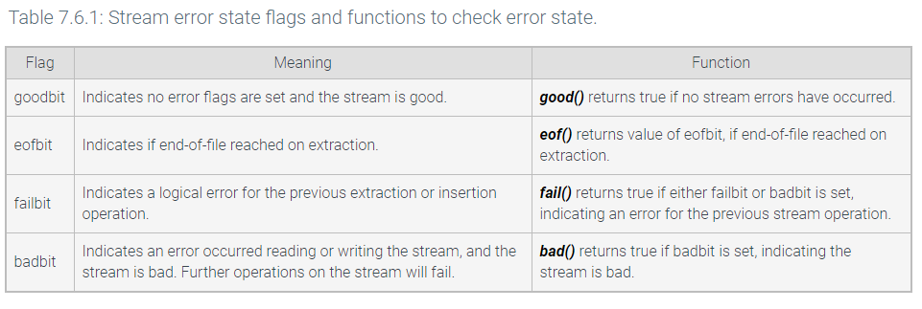
Stream Errors

Slide 46
cin.ignore()
ignore(maxToIgnore, stopChar)
ignores characters in the stream buffer.
Ex: cin.ignore(10, '\n') ignores up to 10 characters in the stream buffer, or until a '\n' character is encountered.

Slide 47
Chapter 7
Section 7.7

Slide 48
getline vs >>
getline and extraction operator deals with newline in different ways
The getline() function reads a line of text from a buffer, discarding the ending newline character.
The extraction operator >> skips whitespace, then reads the next item such as an integer or string which is said to end at the next whitespace, leaving that ending whitespace character in the buffer (an exception being for reading a single character).
cin >> myInt;
getline(cin, nextLine); \\ newline character from previous cin interferes \\with getline
One possible solution inserts cin.ignore(), which discards the next character in the input buffer. Another possible approach inserts another getline() call, ignoring its blank string.

